Slide 1
Data Structures: WSU Basket Ball Analysis
John Salmon

Slide 2
Goal of analysis
Want to see which games were the most and least challenging
Use the score difference between the two teams to gauge the challenge level
i.e if they were able to score 40 points up on the opposing team, the game was likely a bit easier than a game where they ended 8 points up.
Not looking at individual player stats or other metrics for the team, just the score difference.
Compare and contrast the speed, efficiency, and ease of use of the Heap(Max) and Binary Search Tree

Slide 3
The Data
Sourced as a .csv from SportsReference.com
01
Contains a large amount of information about each game played this season
02
Because season is over there are no missing, null, or NA values.
03

Slide 4
Cleaning
Loaded as a spreadsheet into excel
Fixed some column names for brevity
i.e. WinsAndLosses -> WorL
Adjusted the location column to contain easier to read and understand symbols. Home -> H, Away to -> @, Neutral Venue -> N
Didn’t have to correct or fill any missing or null values
Dropped all columns that weren’t relevant to goal.
Final data set contains
Game Number, Date Played, Location of game, Opponent, Outcome (Win or Loss), Cougar’s Score, Opposing Teams Score.

Slide 5
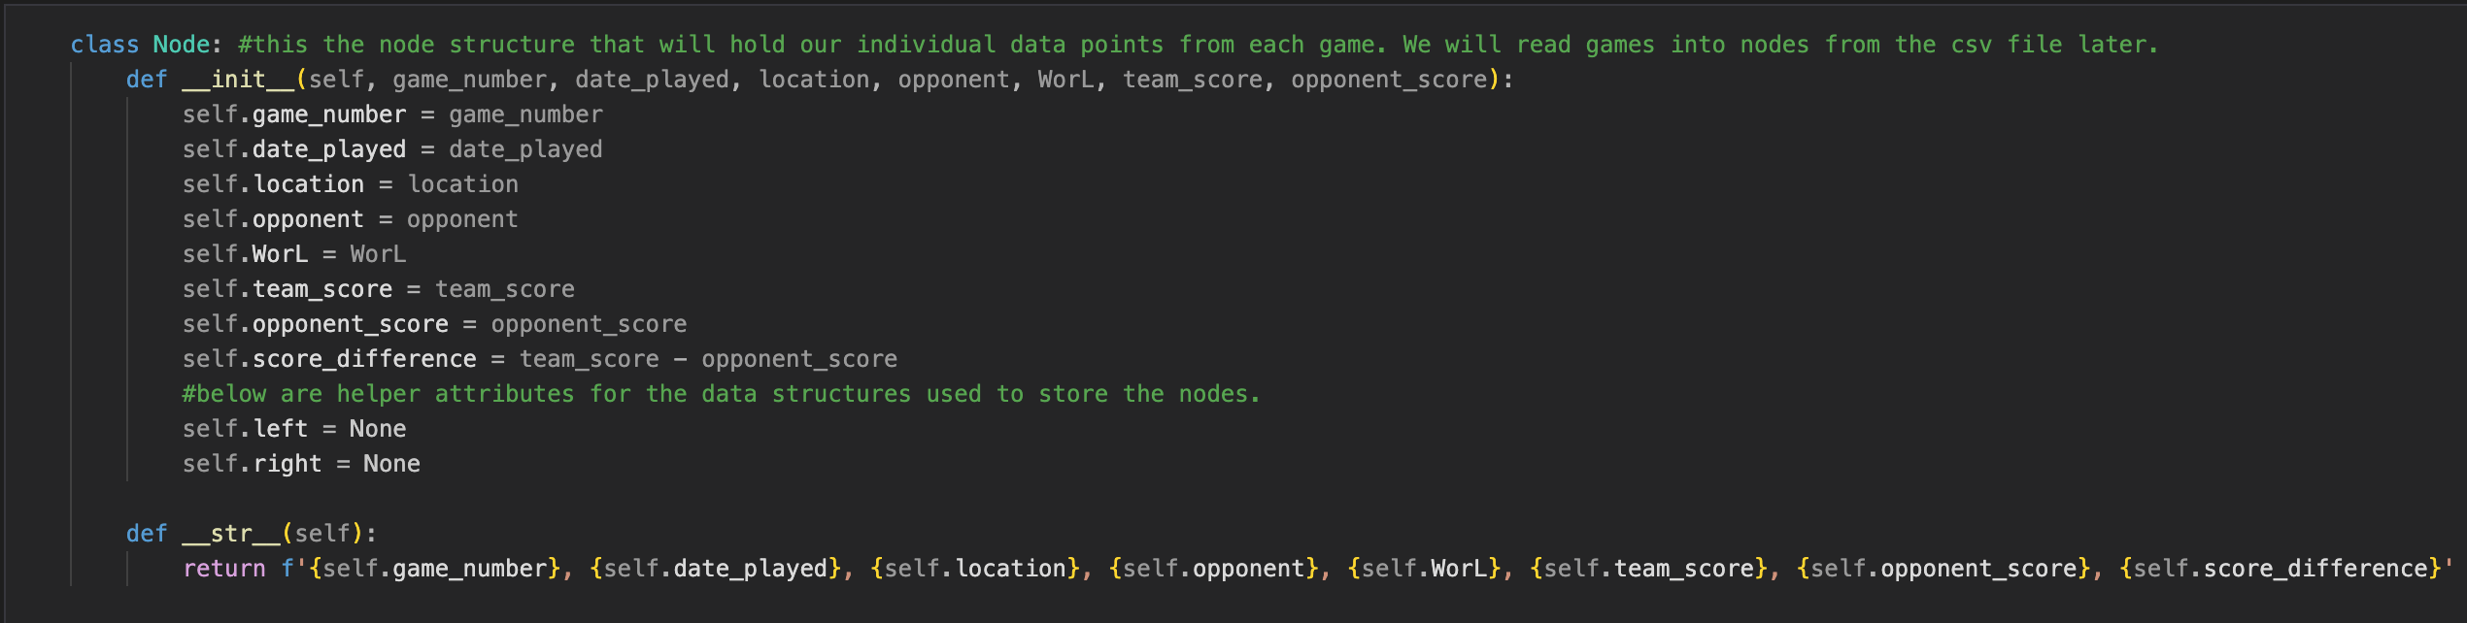
Node Structure
Nodes Contain an attribute for each field specified in cleaning
Score Difference is calculated on initialization
Coug’s Score – Opposing Teams Score
Also contains Left and Right for BST and a __str__ function for printing

Slide 6
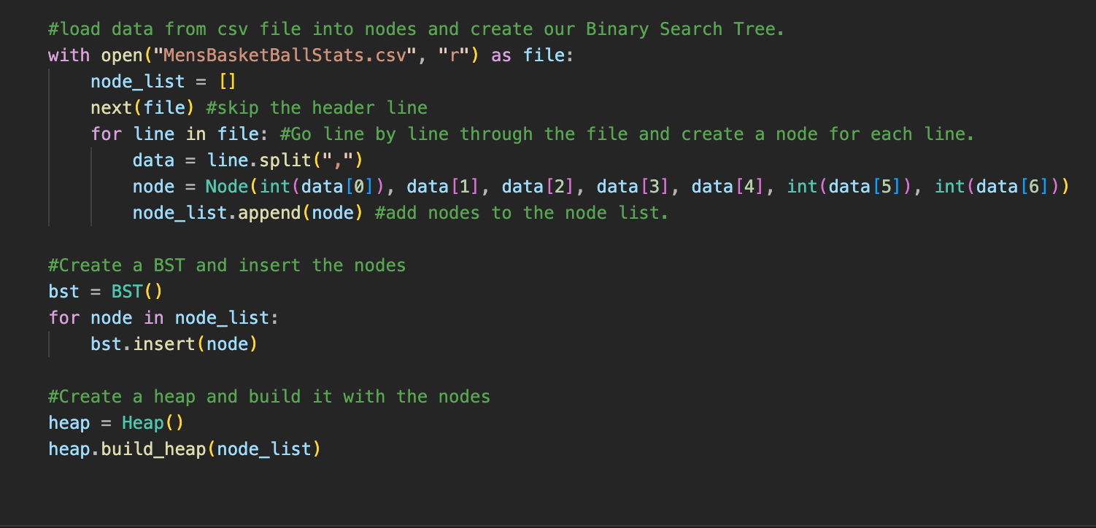
Loading Data and Performing Analysis
Read .csv file line by line and inserted each games value into a node.
For BST, nodes were inserted into them based on the score difference value as the nodes were created.
For Max Heap, Nodes were placed in a list then “Heapified” once all nodes were created
Each structure had 3 different operations performed:
Find Min and Max
Search for a specific score difference value
Sort and return games in ascending score value order.

Slide 7
Results
Successfully found the Max and Min Score difference Game with both structure
Max: 11/24/23 WSU vs Utah Tech @ WSU, with a score difference of 40
Min: 12/29/23 WSU vs Utah @ Utah(Away), with a score difference of -22
Successfully searched each tree for a game with a score difference of 0, 8, and 17
Successfully Sorted and Returned the full list of games sorted into ascending order by Score difference

Slide 8
Binary Search Tree vs. Heap(Max)
Binary Search Tree
Max Heap
Very easy and Fast to find Minimum and Maximum values
Follow tree to left and rightmost nodes
O(h) h = height of tree
Searching Values was slower
My BST was unbalanced
O(log(n)) n = number of Nodes
Sorting is quick and easy
In order Traversal of Tree
O(n), n = number of nodes
Finding Maximum is very easy
Top most (First) Node
O(1) – practically instant
Finding Minimum (and searching)
Traverse structure to find minimum value
O(n), n = number of nodes
Sorting is much more interesting
Access to Heapsort Algorithm
”Pop” off top node (max) then ”heapify” again
Leads to quick sorting of large data sets because of swift inserting and removal procedures using heaps
O(log(n)), N = number of nodes
Outperforms BST in order traversal for data sets with more than 10 nodes

Slide 9
Conclusion
In this application BST outperforms Heap
Quickly returns both Min and Max
Searches with the same speed
Sort is only slightly slower because our data set is not very large
Heap is more efficient for applications that require constant inserting and removal of data
It is very efficient at inserting values because of its “bubble up” property
Worst case you just move a value from the bottom to the top. O(log(n))

